Slide 1
Introduction about gRPC
For Java Developers
Presenter: Ngô Hồng Quang

Slide 2
Monolithic Application

Slide 3
MicroServices

Slide 4

Problem when call service in microservice

Slide 5
Problem - 1: Request & Response Protocol
Service A
Service B
Service A
Service B
HTTP /book/41
Notes:
in-process method call
Nhiều service, nhiều connection
Wait response before send next request

Slide 6
Problem - 2: Headers
HTTP is stateless
Headers are sent in every request
Carries info like Cookie
Plain text - relatively large in size
Can not be compressed
Notes:
Gửi đi ,nhận về ở mỗi request, res nó chứa thông tin chủ yếu về client và server. CỤ thể là thông tin trình duyệt,cấu hình server, ngày tháng request page
Http2 thì có thuật toán để compress là HPACK
Reference:https://stackoverflow.com/questions/5333367/http-header-compression

Slide 7
Problem - 3: Serialization & Deserialization
“firstName”:“Quang”
“firstName”:“Quang”
Service A
Service B
Notes:
Phải chuẩn chỉnh vì protobuf nó quy định rồi,2 ông code khác nhau vẫn chơi với nhau đc
Plainttext Large in size, take a lot of time CPU memory to send and process

Slide 8
Problem - 4: API Contract
“first_name”:“Quang”
“firstName”:“Quang”
Service A
Service B
Notes:
L

Slide 9
Solution
Rabbit MQ(Message Queue)
RPC(Remote Procedure call)
WCF(Window communication foundation)
Notes:
AMQP: Giao thức Advance Message Queuing Protocol, là giao thức truyền message trong RabbitMQ. Đảm bảo server sẽ xử lí request mới thay vì waiting request cũ xong
WCF : window communication foundation thông qua các enpoint gồm các thông tin using tcp và binary format – A: Address (Địa chỉ của service)
B: Binding(How) loại giao thức kết nối giữa client và service(Như HTTP, TCP, MQ)
C: Contact, service và client dùng chung các contact, contract mô tả data to be exchanged

Slide 10
Remote Procedure call
RPC is a request–response protocol
An RPC is initiated by the client, which sends a request message to a known remote server to execute a specified procedure with supplied parameters

Slide 11
Stubby
RPC Framework from Google
15 years
10 billions reqs / sec!!!!
Tightly coupled with infrastructure

Slide 12
gRPC
Developed at Google
Inspired by Stubby
Using Http2
Adopted by
Netﬂix
Microsoft
Notes:
gRPC: một Remote procedure call framework của Google dùng để giúp thực hiện các giao tiếp gRPC một cách nhanh chóng, nhẹ nhàng và hiệu quả. gRPC đã mang RPC kết hợp với protobuf (một định dạng file, cùng chức năng như JSON, XML nhưng nhẹ hơn, nhanh hơn và đơn giản hơn) và HTTP2 - phiên bản mới của HTTP và có nhiều cải tiến về tính năng cũng như tốc độ.
GRPC: hiểu đơn giản là phương thức cho phép một client gọi đến một thủ tục hàm của server khác

Slide 13
Why gRPC is faster in pushing data?

Slide 14
gRPC - Feature
Use HTTP2.
Read Binary instead of plaintext
Multiplexing
Flow-control
Non-blocking
Use Protobuf
Data Transfer Object
Service deﬁnitions
Auto-generated bindings for multiple languages
Notes:
Non-blocking : asyn

Slide 15
Problem in HTTP / TCP
HTTP 1.1 was released in 1997
TCP connection - 3 way handshake process
Signiﬁcant amount of time is spent in establishing a connection

Slide 16
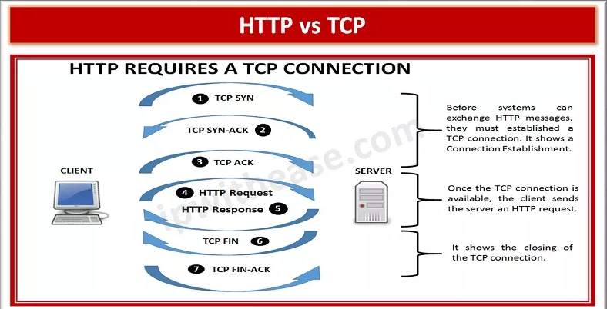
Problem in HTTP / TCP

Slide 17
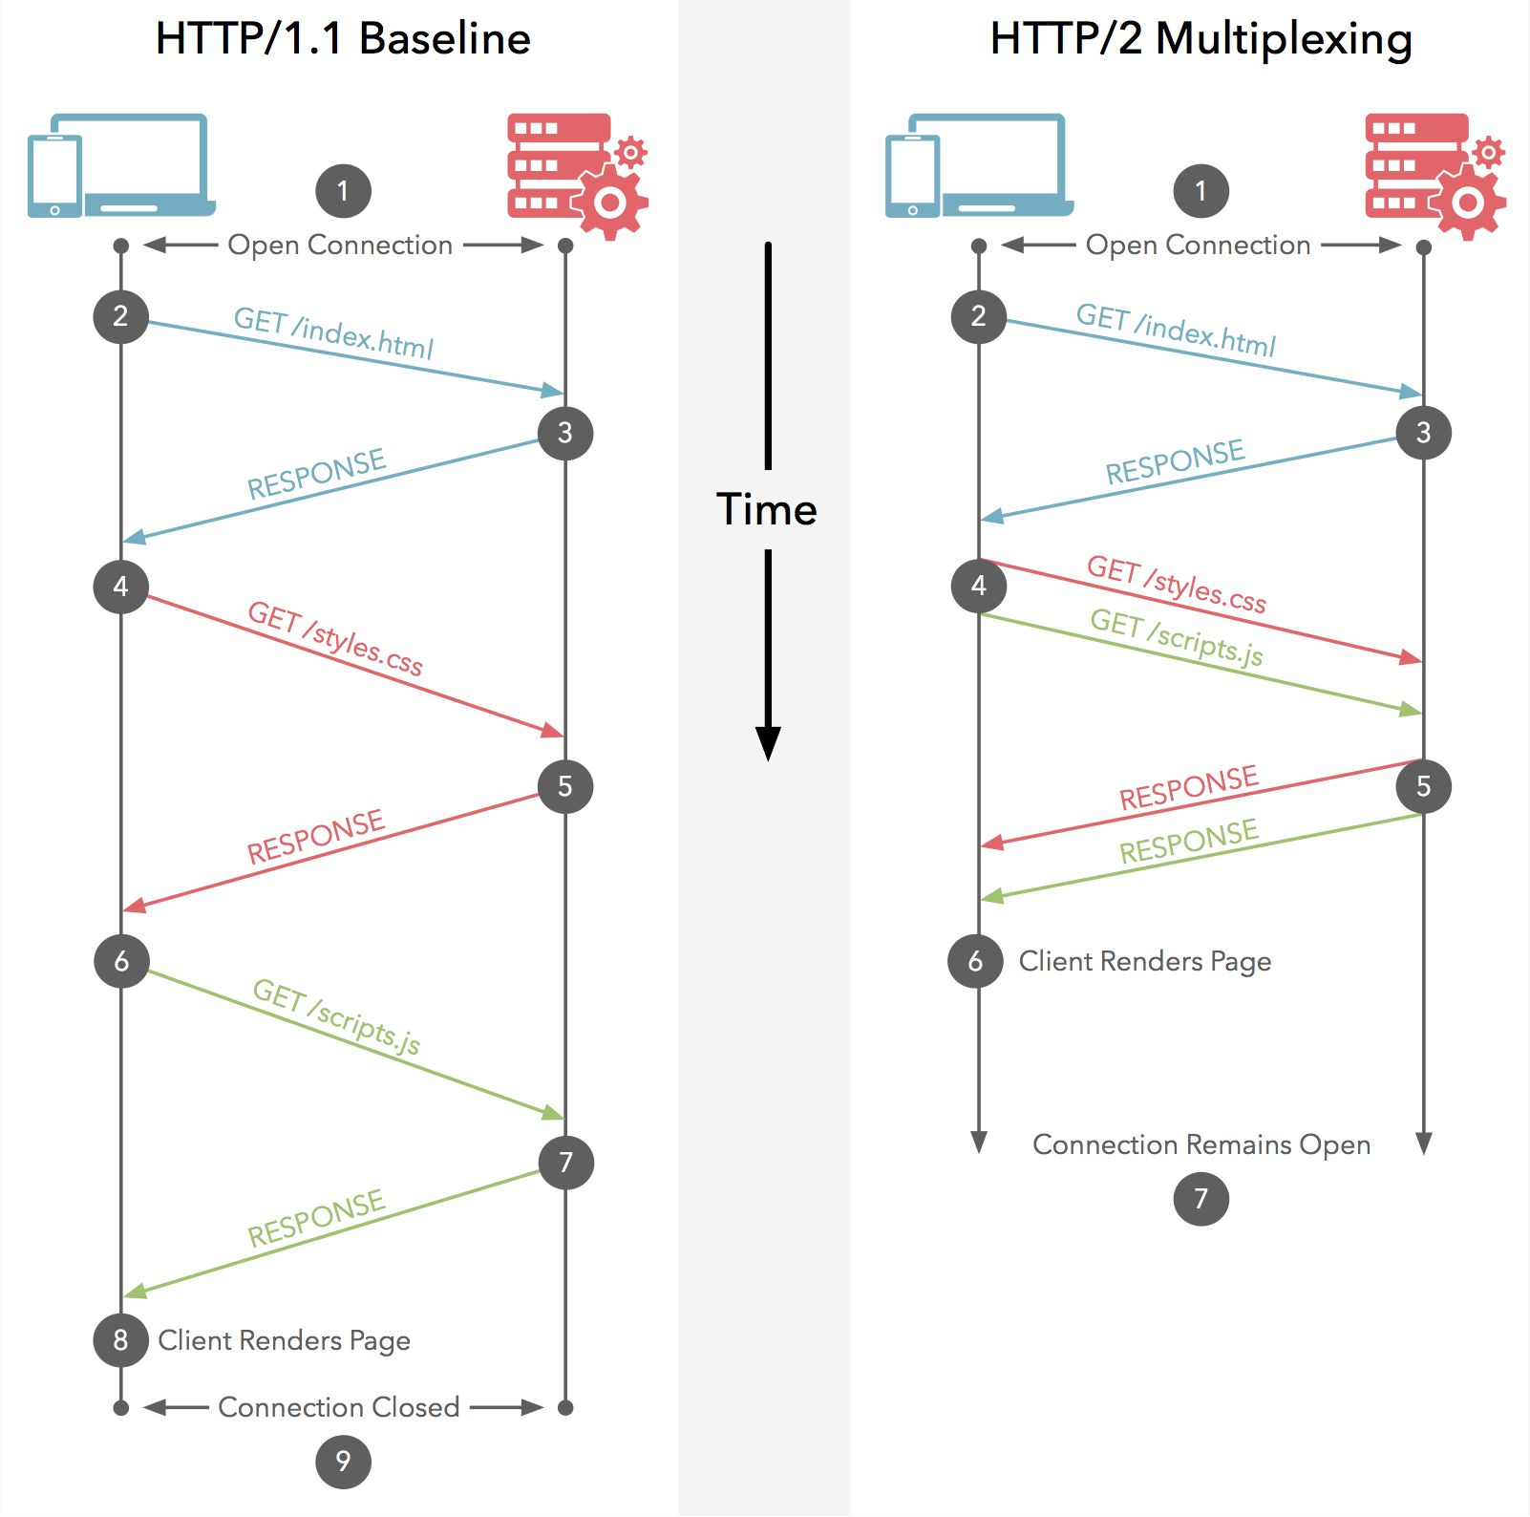

HTTP/1.1 vs HTTP/2
Web Server

Slide 18
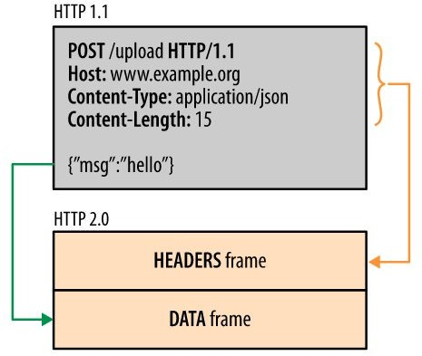
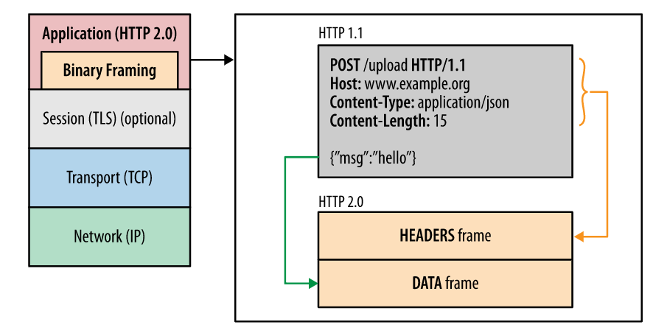
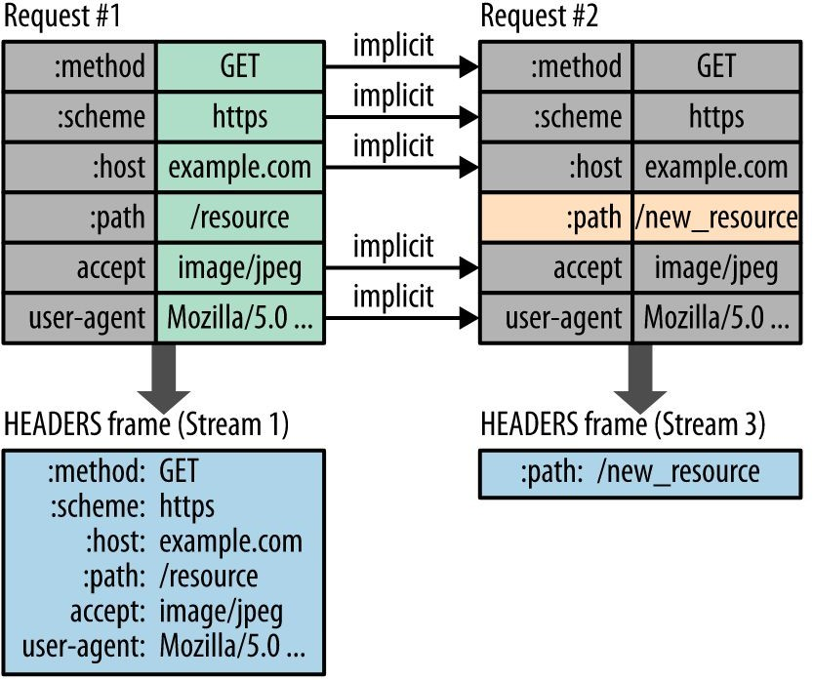
HTTP/2 Feature
Binary framing
Header Compression
Flow Control
Multiplexing
Notes:
- Multiplexing means your browser can send multiple requests and receive multiple responses "bundled" into a single TCP connection
- avoid fetching and buffering unnecessary data from the server
-core is binay framing layer
Streams, messages, and frames

Slide 19
Dive in detail
Protocol Buffers / protobuf
gRPC
Client/Server application
Different types of RPC
Example:
Java code about type of data of Protobuf with Java
gRPC – Spring boot integration

Slide 20
Protocol Buﬀers
Notes:
tạo ra chuẩn sắp xếp mã hóa data với mục đích tạo buffer truyền và nhận giao tiếp một cách linh hoạt, hiệu quả, đơn giản và tăng tốc độ truyền nhận

Slide 21
Introduction
IDL (interface description language) for API
Serializing/Deserializing structured data
Very Fast / Optimized for interservices communication
Provides client libraries automatically for many languages!
Java
C++
Javascript
Go
Ruby
C#
Python
Notes:
chuẩn sắp xếp mã hóa data với mục đích tạo buffer truyền và nhận giao tiếp một cách linh hoạt, hiệu quả, đơn giản và tăng tốc độ truyền nhận cùng chức năng như json nhưng nhẹ và nhanh hơn

Slide 22
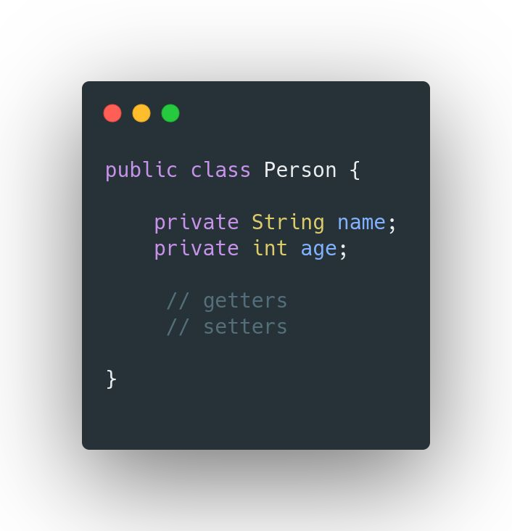
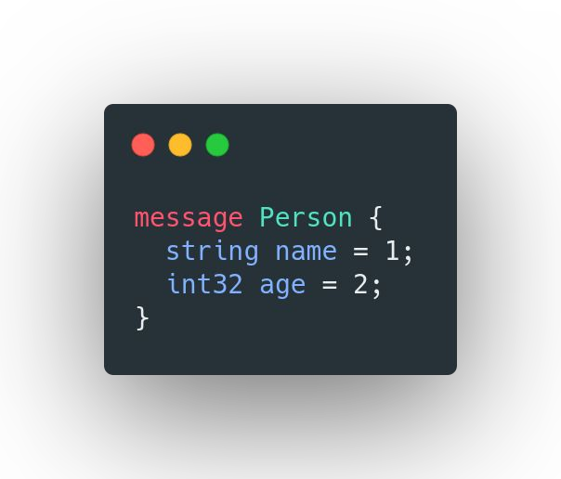
Sample Proto

Slide 23

Protobuf vs JSON - Performance Comparison

Slide 24
Types
Java Type | Proto Type
int | int32
long | int64
float | float
double | double
boolean | bool
String | string
byte[] | bytes

Slide 25
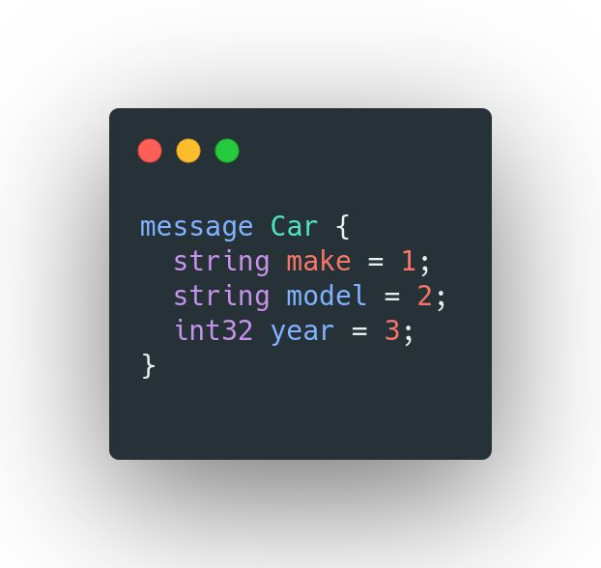
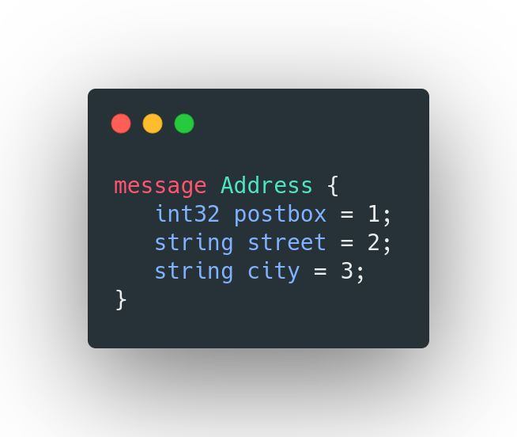
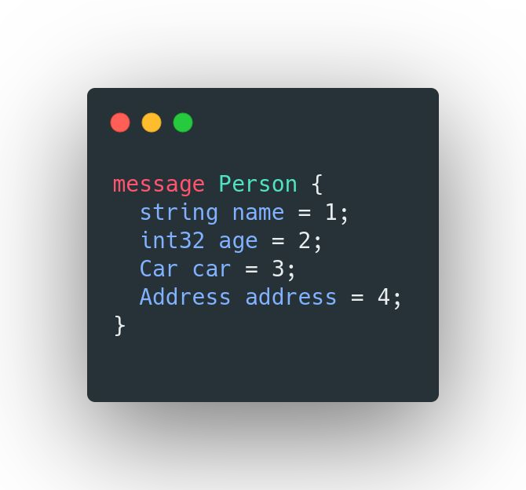
Proto - Composition

Slide 26
Proto - Collections & Map
Java Type | Proto Type
Collection / List | repeated
Map | map

Slide 27
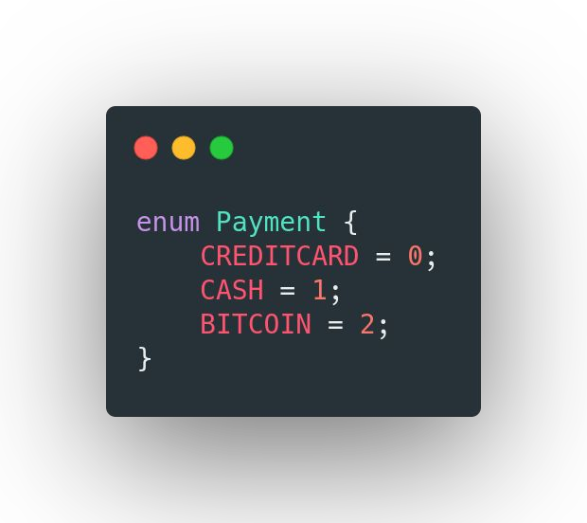
Proto - Enum

Slide 28
Default Values
Proto Type | Default
int32 / any number type | 0
bool | false
string | empty string
enum | first value
repeated | empty list
map | wrapper / empty map

Slide 29
Proto - Modules / Import
Proto ﬁles can be packaged & imported

Slide 30
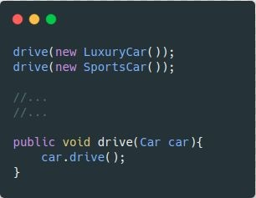
Java - Interface / Implementations
Car
SportsCar
LuxuryCar

Slide 31
Proto - OneOf
Email
Phone
Credentials

Slide 32
Proto - Field Numbers
Each Field is assigned with unique number.
1-15 for frequently used ﬁelds (uses 1 byte)
16-2047 - uses 2 bytes
1 is smallest
Do not change the ﬁeld number once it is in use

Slide 33
Proto - Guidelines
1-15 for frequently used ﬁelds
Do not reorder the ﬁelds once it is in use
Adding New ﬁelds will not break old proto
Removing ﬁelds will not break old proto
Use reserved
Changing Type
int32 → int64 is OK
int64 → int32 might be a problem
Renaming is OK. but be cautious.
Keep the protos as separate module and add them as dependency in other modules

Slide 34
gRPC

Slide 35
gRPC - Introduction
High-performance, open-source RPC framework
Developed at Google
Service is deﬁned using proto
.proto

Slide 36
gRPC - Synchronous vs Asynchronous
Client’s call to the server can be Sync/Async
Sync → blocking / waiting for the response
Async → Register a listener for call back
It is completely up to the client
It also depends on the RPC

Slide 37
RPC - Types
Unary
Server-streaming
Client-streaming
Bidirectional-streaming

Slide 38
gRPC - Services Communication
Client
Server

Slide 39
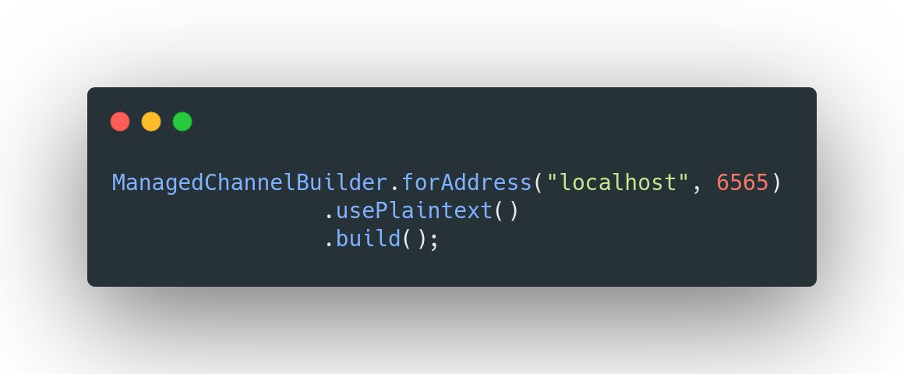
gRPC - Channel
Channel is an abstract over a connection and represents the connection

Slide 40
gRPC - Channel
Connection is persistent
Connection creation is Lazy & established during the ﬁrst RPC
1 channel / connection is enough for client/server communication even for concurrent requests
You can also create more channels - but not really required.
Channel creation is an expensive process.
Close when the server shuts down
Thread safe!
Can be shared with multiple stubs for the server

Slide 41

StreamObserver
CashDeposit stream observer
Balance stream observer

Slide 42
Bi-directional Stream
TransferRequest stream observer
TransferResponse stream observer

Slide 43
Response - Streaming vs Single
Streaming
Size - Potentially large / unknown
Ex: Pagination
Uber-eats
Receiving side might take too much time to process
File upload
More efﬁcient than multiple RPC calls
Bi-Directional Stream → Client/Server streams are completely independent
Single(In unary)
More efﬁcient than streaming RPC
Size is small

Slide 44
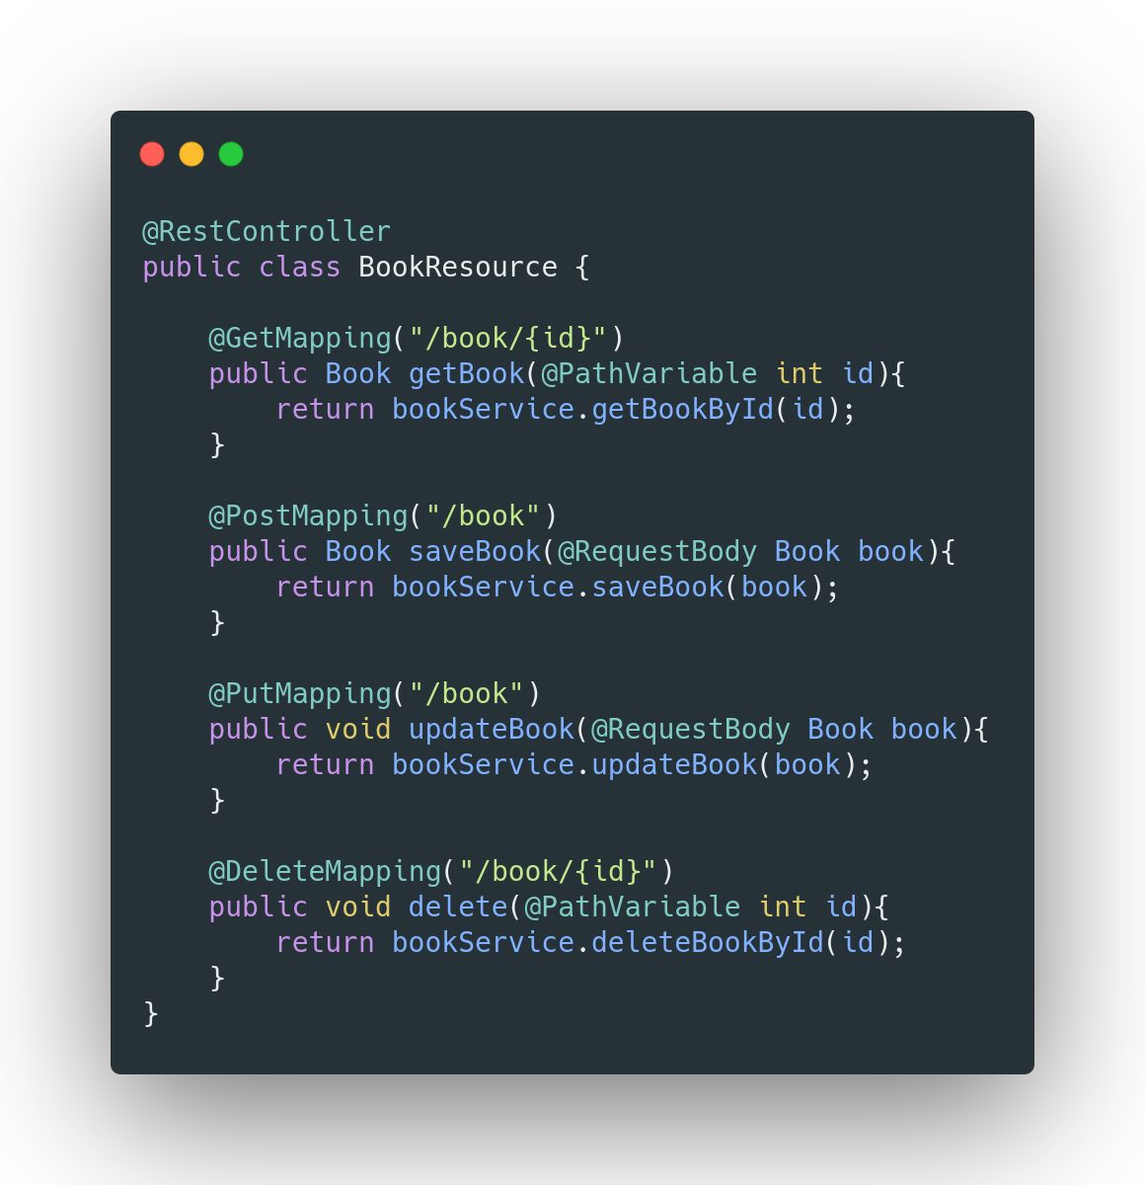
REST - CRUD
GET
POST

Slide 45
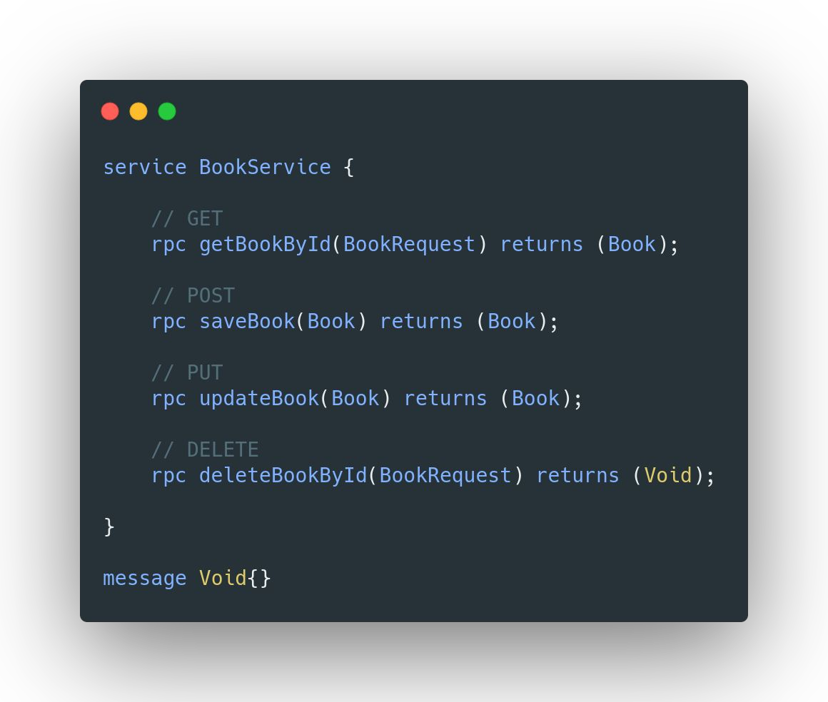
gRPC – CRUD definition inside Proto

Slide 46
gRPC – some advanced Topics

Slide 47
gRPC - Deadline
Timeout for an RPC to complete!

Slide 48
gRPC - Interceptor
We can intercept RPCs both at client and server side.
To handle Cross-cutting Concerns

Slide 49
gRPC - Key/Value Pairs
Metadata
CallOptions
Context

Slide 50

gRPC - Attaching User Token
Metadata

Slide 51
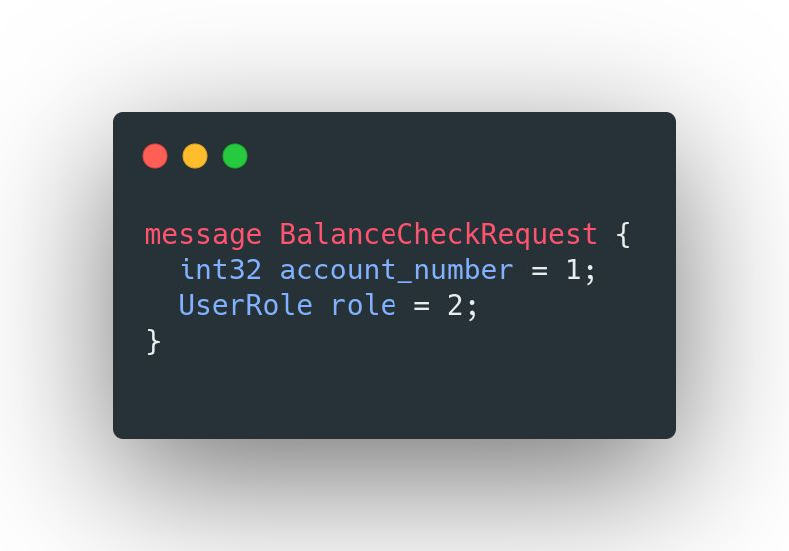
gRPC - Passing User Role via Context
Metadata
Context

Slide 52
gRPC - Metadata
Key/Value pairs
Value can be a String or Binary data or an Object
To pass information between Client & Server

Slide 53
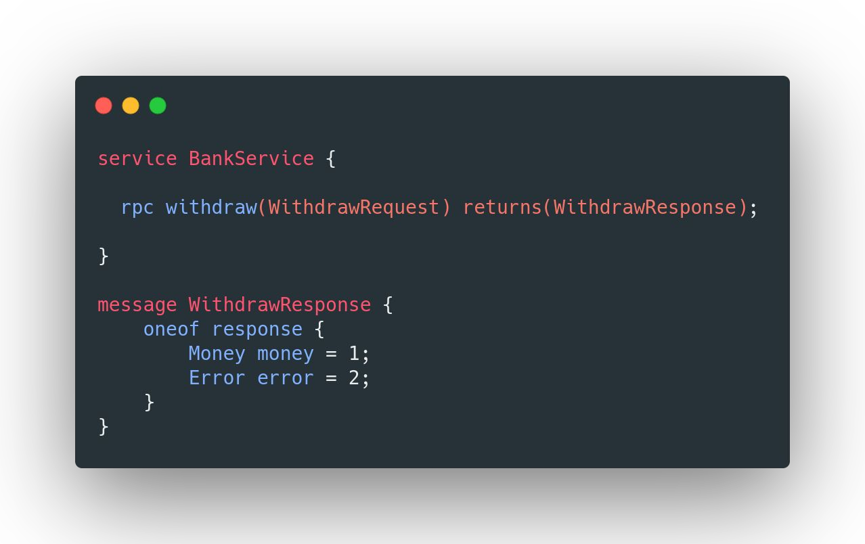
gRPC - Error Handling
Error channel
Status codes
Metadata
Data channel
OneOf

Slide 54

gRPC - SSL/TLS
CA
mybank.com
https://mybank.com

Slide 55

gRPC - Executor
CachedThreadPool - default
directExecutor → Better performance for non-blocking app
FixedThreadPool → Preferred

Slide 56
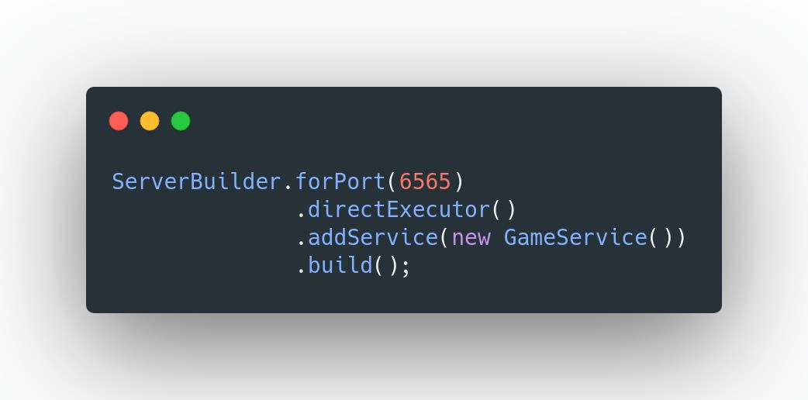
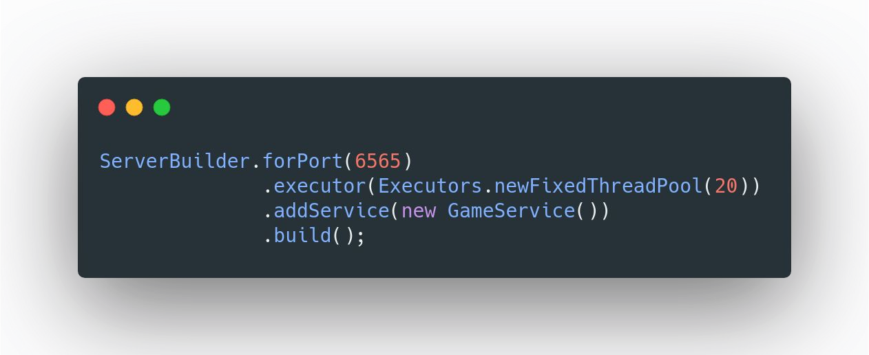
gRPC - Executor

Slide 57
gRPC - Spring Boot Integration

Slide 58
gRPC - Web
HTTP1
Microservice / GraphQL / Envoy

Slide 59
gRPC - Spring Boot Integration
user-service
aggregator
movie-service

Slide 60
gRPC - Load Balancing

Slide 61
gRPC - Load Balancing
order-service
payment-service

Slide 62
gRPC - Server-Side Load Balancing
payment-service
order-service
proxy

